Slide 1


Prepaid Energy Meter with GSM Technology using LabVIEW

Slide 2
ABSTRACT
The project aims at a system that will reduce the loss of power and revenue due to power thefts and other illegal activities so that we can create a more resourceful world. It also helps in saving time and money spent on buying your Electricity.

Slide 3
PROBLEM STATEMENT:
With a growing population, we must all be smarter with the resources we have
MISSION :
The aim of the project is to minimize the queue at the electricity billing counters and to restrict the usage of electricity automatically, if the bill is not paid.
VISION :
To provide customers Speed, Convenience (No contracts, no monthly bills) and accessibility.

Slide 4
EXISTING METHODOLOGY
It requires large number of labor operators and long working hours to accomplish the task.
Manual billing is sometimes restricted and delayed by bad weather conditions.
Readings made by human operators are prone to errors.

Slide 5
PROPOSED AND EXISTING
In existing system either an electronic energy meter or an electromechanical meter is fixed in the premise for measuring the usage. The meters currently in use are only capable of recording kWh units.
Proposed Method: Prepaid Energy Meter has been proposed as an innovative solution aimed at facilitating affordability and reducing the cost of utilities. This mechanism, essentially requires the users to pay for the electricity before its
consumption.

Slide 6
OBJECTIVE
This mechanism essentially requires the users to pay for the electricity before its consumption. In this way, consumers hold credit and then use the electricity until the credit is exhausted.

Slide 7
HARDWARE DESCRIPTION
Components required:
NI MyDAQ
LED
GSM
RS 232
Power Supply
Output Load

Slide 8
BLOCK DIAGRAM
GSM Module
Power Supply
MyDAQ
Display
Output Load

Slide 9
FLOW CHART
Start
Balance>0?
No
LED OFF
Recharge Options
Yes
Recharge?
Yes
LED ON
No
Watt / Unit Measurement
Stop
Balance - Price per unit

Slide 10
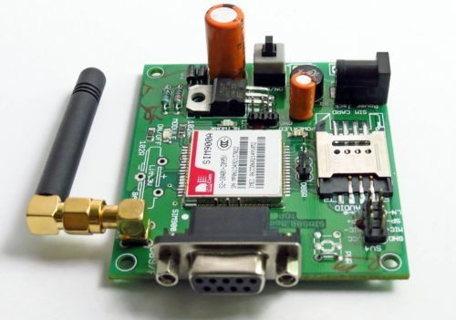
KEY POINTS
The GSM technology is used so that the consumer would receive messages about the consumption of power
The project also aims at proposing a system that will reduce the loss of power and revenue due to power thefts and other illegal activities.
The GSM module is used to send a message to the consumer about the units of power consumed and their balance and
also the balance amount is shown.
MyDAQ connects real-world data
to LabVIEW so you can manipulate
and process the results.

Slide 11
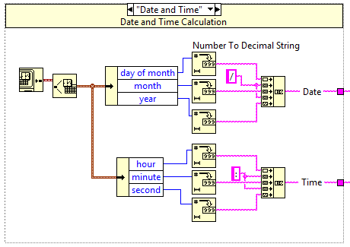
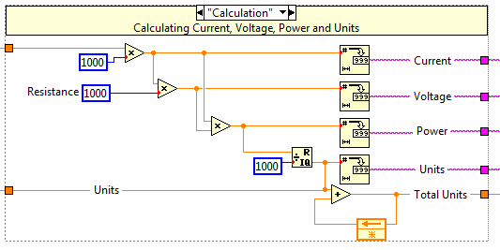
Working Model Snapshots
This is the Block diagram for the calculation of the Date and Time We can see in the figure that the output lines are indicated with a tag as Date and Time.
In the same way as said above, here it displays the values calculated for current, voltage, Power, Units and the total units used.

Slide 12
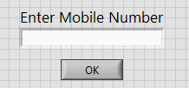
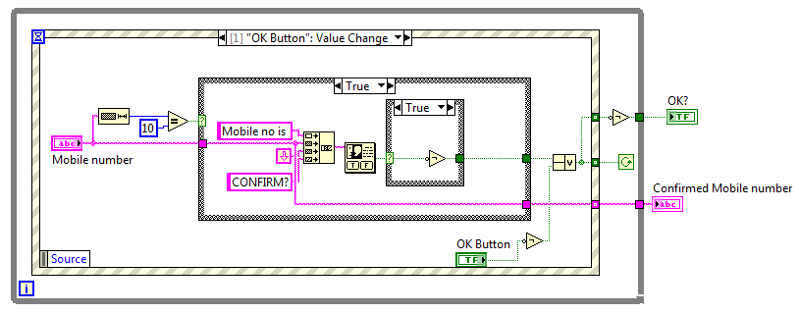
Working Model Snapshots
This is the front panel of the mobile number to which the message has to be sent.
The Block diagram of the mobile number is given below.
here the length of the input is compared and when the length is 10 only that accepts the number or else, it’ll throw a dialogue box saying, that is an invalid number.

Slide 13
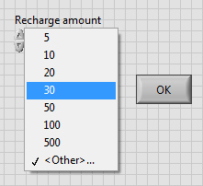
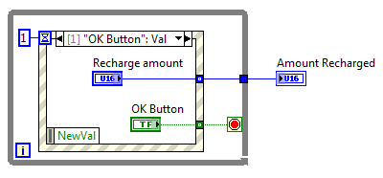
Working Model Snapshots
This is the front panel which is used as the input for the amount to be recharged. We can see in the figure that different selections are displayed. We should send only one of them.
In the same way as said above, here it displays the block diagram of the recharge amount.

Slide 14
RESULTS
If the available credit is exhausted then the electricity supply is cut off using DAQ.
An arrangement is also made to intimate the user with the help of GSM communication module when their credit in their balance goes low.
This module will reduce the burden of energy providing by establishing the connection easily and no theft of power will take place.

Slide 15
SWOT ANALYSIS
SWOT ANALYSIS | STRENGTHS | WEAKNESS
Opportunities | Wastage of energy is diminished as only the required energy will be consumed as allotted. | Charges may be applicable for the network usage.
Threats | Consumer cannot escape from paying the electricity bill and the State Electricity Board gets free from debts. | Billing system fails if no GSM network coverage.

Slide 16
CONCLUSION
Using this project we can reduce the manual efforts to take the readings from the energy meter which is cost effective solution.
It is user friendly in which we can send an message to the consumer about the Energy used or Balance and other information.
Prepaid energy meter will bring a solution and create awareness on unnecessary wastage of power and will tend to reduce wastage of power.

Slide 17
FUTURE SCOPE
In future, We can implement the same kind of logic for applications like Gas, Water and other resources.
We can add a printer in every house and send print command to send a copy of the data to the customers.

Slide 18

REFERENCES
Loss.P.A.V, Lamego. M.M and Vieira.J.L.F, “A single phase microcontroller based energy meter”, IEEE Instrumentation and Measurements Technology conference St. Paul, Minnesota, USA, May 18-21, 1998.
Saptarshi De, Rahul Anand, A Naveen and Sirat Moinuddin, “E-Metering Solution for checking energy thefts and streamlining revenue collection in India”, Student Member, IEEE, 2003.
Ali Zaidi.S.K., “Design and implementation of low cost electronic prepaid energy meter”, Multitopic Conference, 2008. INMIC 2008.IEEE International 2008.
www.ni.com (National Instruments, LabVIEW)
www.google.com

Slide 19

THANK YOU !

